Slide 1
MOVIE REC ENGINE
DS 4300 Final Project
Naomi, Luke, Esther, Max
Notes:
Max

Slide 2




OUR TEAM
MAX FREEMAN
LUKE HONG
ESTHER ANEMEJE
NAOMI KIM
Notes:
Max

Slide 3






What Netflix spent on original content in 2020
WHY IS THIS IMPORTANT?
$17 Billion
Streaming Wars → Fierce Competition
Generate new users and maintain existing
How do they keep users locked in?
Notes:
Currently, consumers are finding themselves caught in the crossfire of the Video Streaming Wars. This essentially consists of large corporations, such as Netflix, HBO, and Disney, vying for users’ attention and subscription dollars with proprietary streaming platforms offering exclusive and licensed content across large catalogs of TV shows and movies. In 2020 alone, Netflix spent over $17 billion on producing original content to compete. Given the massive amounts of spending happening to generate new user subscriptions and maintain existing ones, recommendation engines for these platforms are becoming increasingly vital to success. If a streaming service can successfully keep users locked in with content tailored to their specific viewing habits, they have a much better chance at maintaining and growing subscriptions. Since this is so important, we aim to create our own recommendation engine for movies specifically to gain insights into how these large corporations keep viewers logged in for hours on end.

Slide 4
PROJECT OVERVIEW
Our goal is to build a recommendation engine in Python using our graph model that will return a list of movies recommended based on a movie or user.
Notes:
For our project, we used the movie dataset from gaggle which had over 45,000 movies and over 270,000 users. Our goal is to build a recommendation engine in python using our model we built in neo4j that will return a list of movies recommended based on a movie or user.

Slide 5
(:User) - [rate] -> (:Movie)
(:User) - [similarity] - (:User)
(:Movie) - [similarity] - (:Movie)
Graph Model
Notes:
This is our tentative graph model.
Users rate movies, users are similar to another user in a way and movies are similar to another movie in a way.
These relationships we defined through the different approaches each of us looked at which were either collaborative or content-based.
Collaborative filtering is concerned with the the preferences of the user compared to content-based filtering which is based on the features and properties of the items.

Slide 6
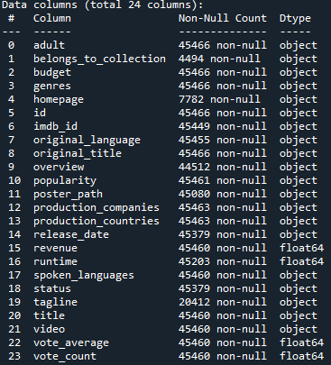
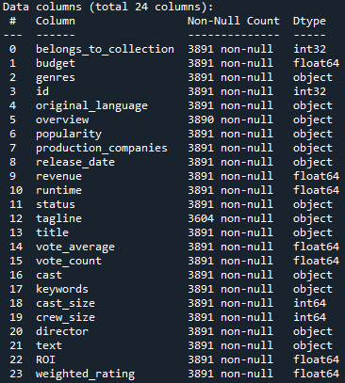
DATA WRANGLING
RAW DATA
CLEANED DATA
Notes:
Standard data wrangling
Removed insignificant data columns like adult, homepage, imdb_id, original_title, poster_path, production_countries,
Out of 45449 rows, there are many nulls or bad data, either get rid of rows with nulls, replace with mean if possible or just convert it to 0/1 for things like belongs_to_collection
Newly created variables for analysis like Budget revenue for ROI, weighted rating using vote_avg/count, director, popularity, release date, genres, overview/tagline
Combined director and top 3 actors of the cast from a credits table that i joined with on the id
Turning types of id, popularity and budget from object to numeric.
Columns in jason format like genres, cast with multiple values

Slide 7
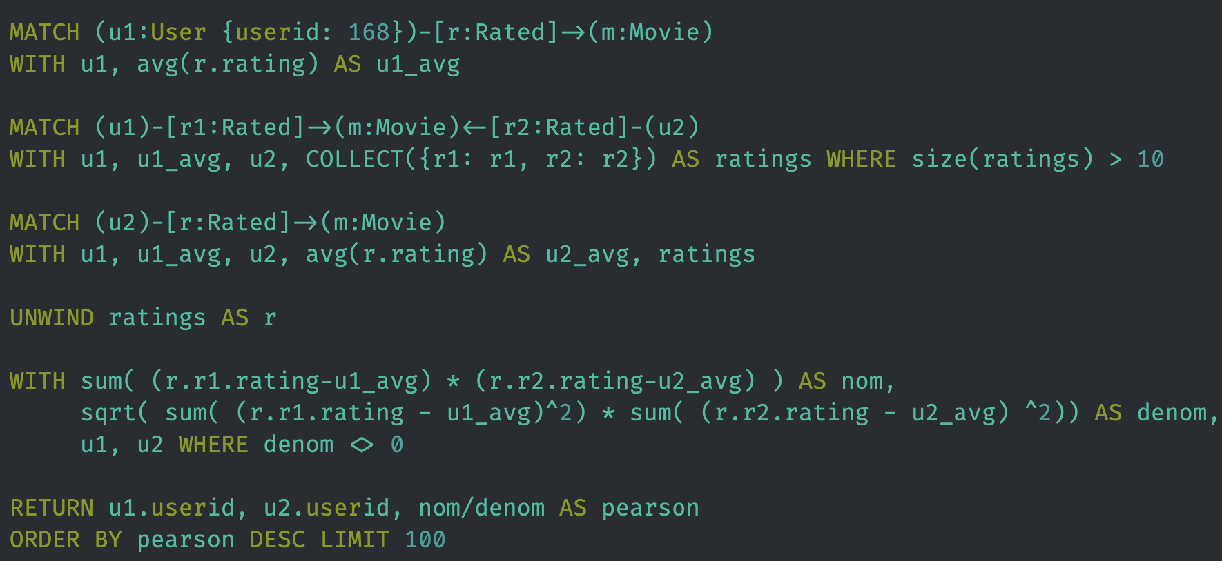
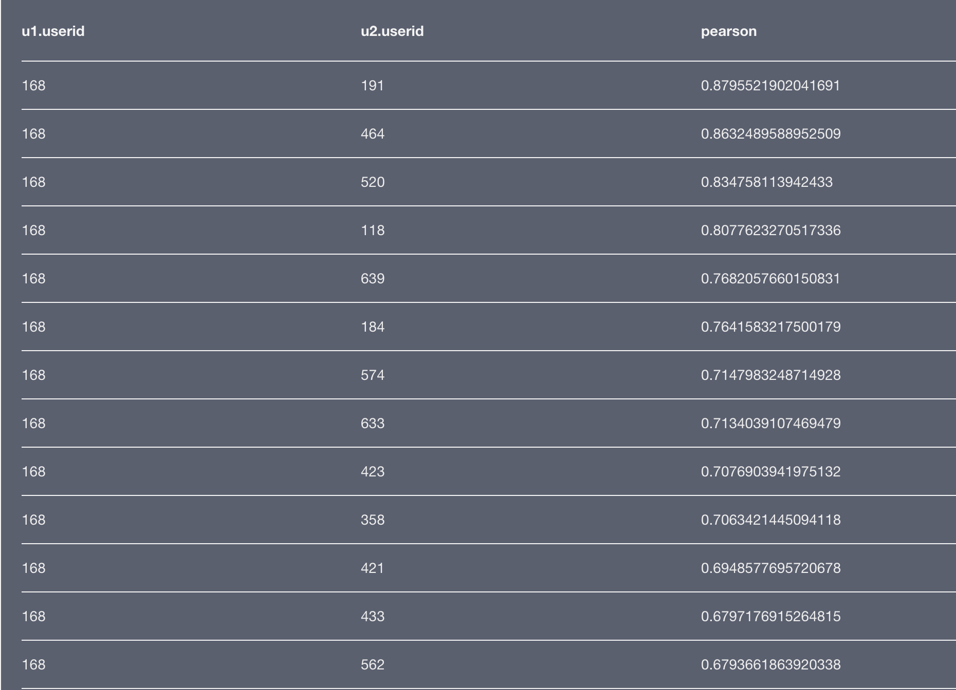
Collaborative Recommendation
Uses Pearson Similarity to identify similar users based on how they rated movies
Notes:
The first method of collaborative filtering we used finds similar users using a procedure known as Pearson similarity. In this case, users have a “rated” relationship to movies, meaning a user gave a movie a certain rating. The Pearson correlation coefficient finds users that rated movies similarly. It accounts for the fact that some users have a tendency to give higher ratings than others and normalizes the ratings based on the standard deviation of the ratings specific to a user. So that’s what the query on the left shows. The table on the right shows the most similar users, in descending order of the Pearson coefficient, to the user with id 168.

Slide 8
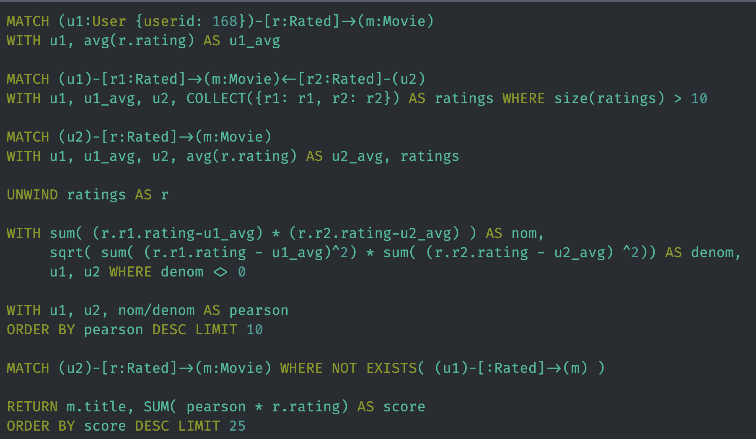
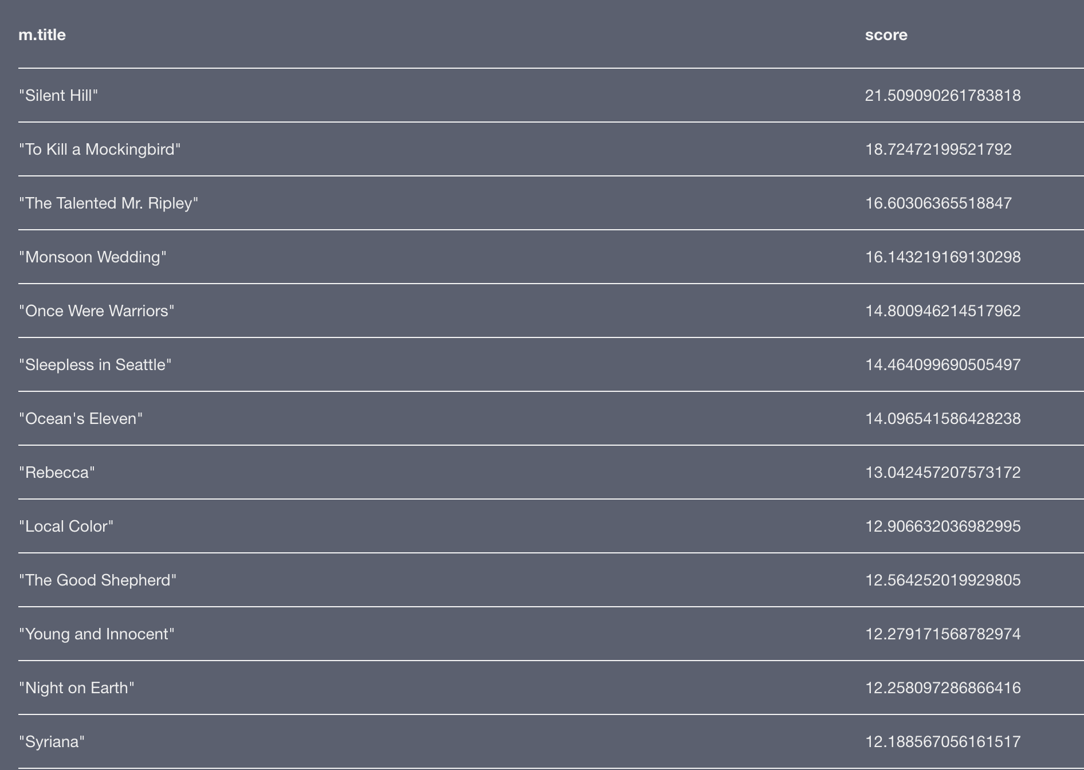
Collaborative Recommendation
Uses k-nearest neighbors (KNN) algorithm to recommend movies watched by the most similar users
Notes:
The next step to get the movie recommendations uses the k-Nearest Neighbors (KNN) algorithm. In this query, we find the 10 most similar users to the given user. We then find the movies those 10 users have watched that the given user has not watched and multiply the Pearson coefficient for a similar user by that user’s rating for the movie. That is how we get the score seen in the right image that shows the recommended movies in descending order of their scores.

Slide 9
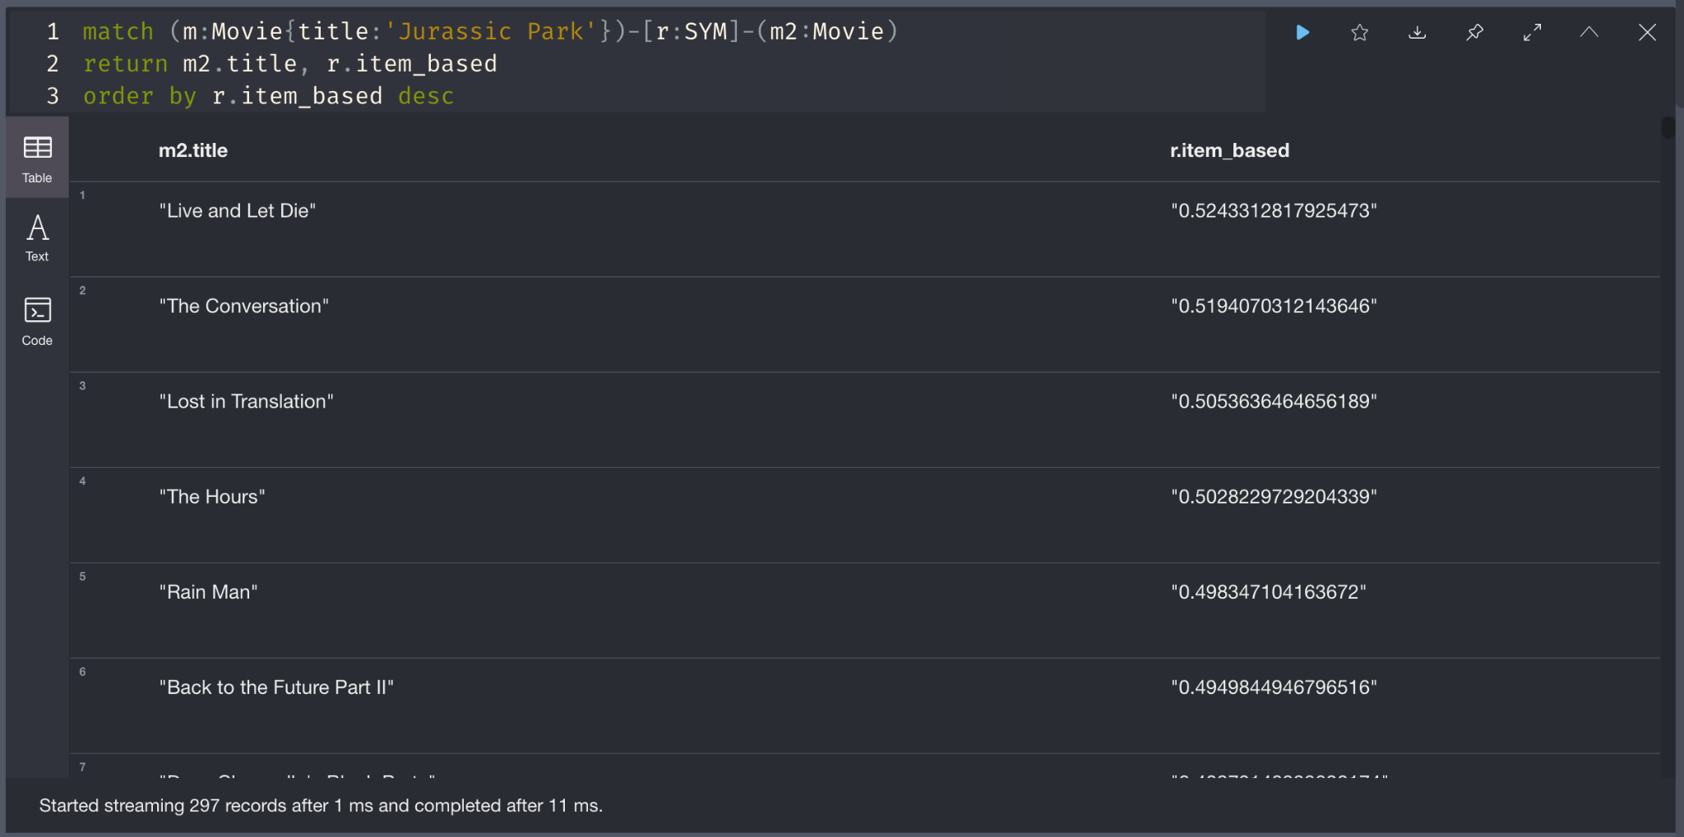
Collaborative Recommendation
Use cosine similarity on the ratings table to compute how similar movies are based on user ratings
Notes:
Another approach in collaborative recommendation is looking at item-based wise in other words how similar movies are based on user ratings. To do this I computed the cosine similarity matrix based on user ratings of the movie, which computes a value between 2 movies. The values are between 0 and 1 where 1 being the exact same.
These values were added to the graph as properties of a relationship similarity between 2 movies.
To retrieve a list of movies based on this approach, for example jurassic park, I returned a list of movies in descending order of the cosine similarity value since the larger number means its closer.
Limitations of this approach is trivial and ratings alone is not enough to build a more effective recommendation engine

Slide 10
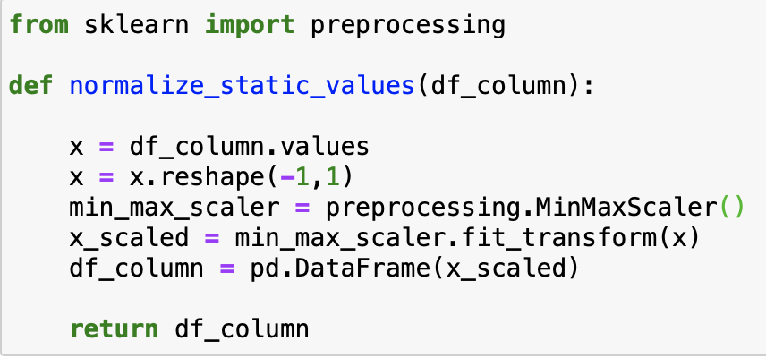
CONTENT-BASED
NORMALIZATION OF STATIC VALUES
RECOMMENDATION FUNCTION
Input: Movie ID, Dataframe
Output: Top 10 Similar Movies
Belongs to Collection: +5 Points
Director: +3 points
Genre: +1 point for each
Production Company: +1 point for each
Cast: +1 point for each
Runtime: +1 point for +/- 15 minutes
Release Year: +1 point for +/- 3 years
Pre-processing on static values (ROI, Weighted Rating, Popularity)

Slide 11
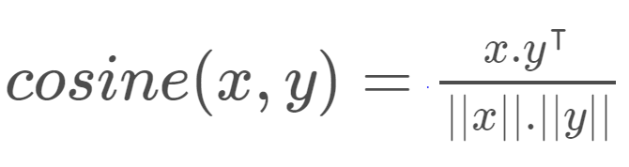
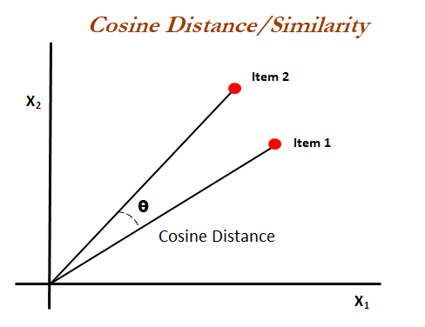
CONTENT-BASED
Cosine Similarity
Weighted Rating Formula
v = # votes for the movie
m = min votes for the movie
R = avg rating of the movie
C = mean vote of all movies
Notes:
I used the Cosine Similarity to calculate a numeric quantity that denotes the similarity between two movies. Mathematically, it is defined as follows:
is a measure of similarity between two non-zero vectors of an inner product space. It is defined to equal the cosine of the angle between them, which is also the same as the inner product of the same vectors normalized to both have length 1. It is a judgment of orientation and not magnitude: two vectors with the same orientation have a cosine similarity of 1, two vectors oriented at 90° relative to each other have a similarity of 0, and two vectors diametrically opposed have a similarity of -1, independent of their magnitude
Used a cosine similarity matrix from sklearn for all the movies in our dataset Metadata dump for every movie which consists of genres, director, main actors/cast and keywords(overview/tagline/description). Use a Count Vectorizer to create a count matrix and calculate the cosine similarities and return movies that are most similar.
IMDB's weighted rating formula to construct my chart. Using vote count and vote average columns
v is the number of votes for the movie
m is the minimum votes required to be listed in the chart
R is the average rating of the movie
C is the mean vote across the whole report

Slide 12
Going forward/ Next Steps
3
2
1
Generate recommendations based on provided users/movie
Merge into Python to create an application using the Neo4j driver
Combine content and collaborative based approaches
Notes:
Going forward, we plan on combining our content and collaborative-based approaches. Then we’ll merge all those approaches into Python where we’ll create an application that uses the Neo4j driver to establish a session allowing us to run our queries. The finished product will allow us to simply pass in a movie title or a user id and retrieve a list of movies that should be watched based on certain criteria.

